Slide 1

Associations of Brain-Predicted Age and Risk of Alzheimer’s Disease Depend on Disease Stage and Modality
Doering, E., Antonopoulοs, G., Hönig, M., van Eimeren, T., Eickhoff, S., Patil, K.*, Drzezga, A.* for the Alzheimer’s Disease Neuroimaging Initiative * authors contributed equally
Notes:
Welcome everyone to this talk. I am Elena Doering and today I would like to present you some of our work on how to best predict brain age in a way that is clinically useful to assess Alzheimer’s disease.

Slide 2
Nothing to disclose.
Notes:
First of all, I would like to thank the organizers of ADPD 2022 for giving me the opportunity to speak to you today and mention that I have nothing to disclose.

Slide 3
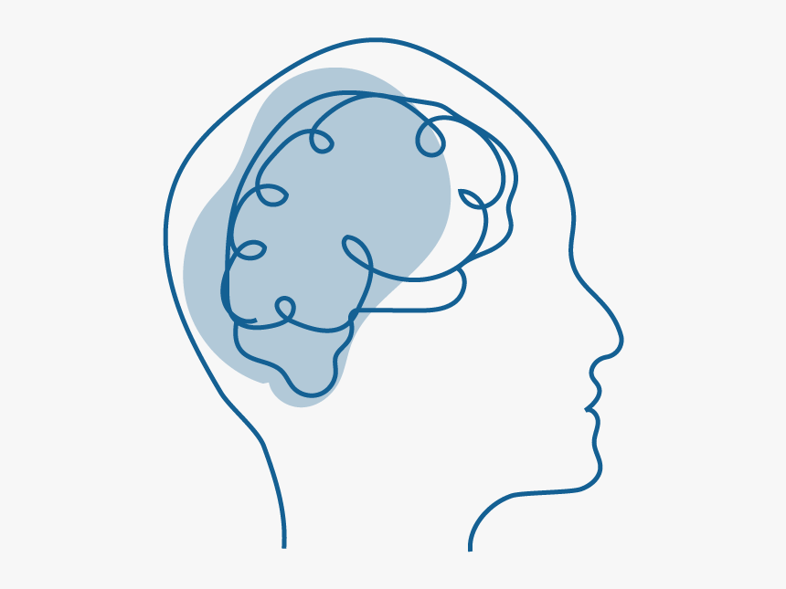
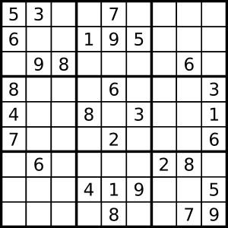

A biological definition of brain age
“Aging is associated with changes in dynamic biological, physiological, environmental, psychological, behavioral and social processes.”
NIA 2020
Notes:
Have you ever stopped to think whether you are as old as your brain? Of course from a purely chronological standpoint that question doesn’t make sense.
But we all know that sometimes our brain makes us feel quite old, or we’ve all probably met people who we thought were cognitively quite fit for their age. According to the NIA, “aging is associated with changes in dynamic biological, physiological, environmental, psychological, behavioral and social processes.”
So basically this indicates that there is a way that we can describe aging , and in this case brain aging, biologically.
So how do we assess brain age biologically?
XX ADDITIONAL IMAGE BUT SUDOKU

Slide 4




Brain-predicted age & BPAD
Brain-predicted age = machine learning algorithms learn to predict chronological age (CA) from brain scans
BPAD
= Difference between chronological age and brain-predicted age
- deviation from “normal” aging in a single number.
age = 75
CA = 63 BPA = 75
Chronological Age = 63
Brain age Prediction
Brain-Predicted Age Difference
= 12 years
Notes:
What is brain-predicted age and how is it assessed?
When machine learning algorithms learn to predict chronological age (CA) from brain scans, we refer to this as “brain age”.
So, for example, if you have a brain scan of a person aged 63 years, you could ask a machine learning model to predict the age. In this specific case, the model estimates a brain-predicted age of 75, thus yielding a brain-predicted age difference of 12 years. This brain-predicted age difference, the difference between brain-predicted age and chronological age, has various clinical functions.

Slide 5
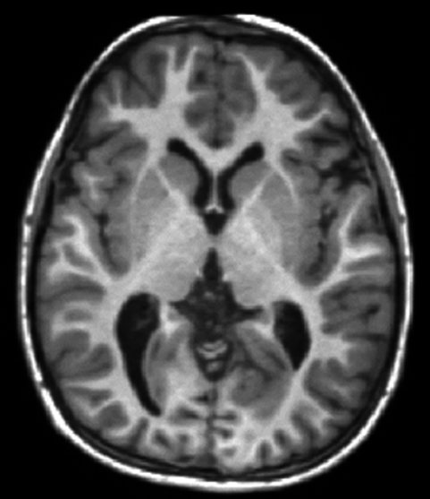
Brain age can have various clinical functions
assess general brain health
detect disorders before symptom onset
support differential diagnosis
Notes:
For example, it can be used to summarize general brain health in one single number. Or it could be used to detect disorders before the emergence of symptoms. Or it could be used to support a differential diagnosis, for example you would expect the brain of a person with Alzheimer‘s disease to be older than that of a person with mild cognitive impairment.
Okay, but which neuroimaging data is actually used to predict brain age? So far, mostly volumetric data, that is, structural MRI scans, were used to predict brain age. However, cerebral glucose metabolism, that is, FDG-PET, may be equally useful in predicting brain age. It could be especially useful in very early stages of Alzheimer‘s disease, as we know that cell metabolism declines before regions degenerate.

Slide 6
Research aims
Precision of brain-predicted age MRI vs FDG-PET in cognitively normal individuals (CN).
Association of brain-predicted age difference (BPAD) in MRI and FDG-PET with cognitive function, neuropathology and cognitive decline
in CN
in individuals with mild cognitive impairment (MCI)
Notes:
This constitutes the basis for the current project.
Our first research aim was to compare the precision of brain-predicted age using MRI and FDG-PET in cognitively normal individuals.
The second aim was to compare associations of MRI and FDG-PET-BPAD with cognitive function, neuropathology and risk of cognitive decline in CN.

Slide 7



Participants
Table 1. Overview of samples
 | CN | CN_validation | MCI
n total | 367 | 59 | 621
Age [avg. years (SD)] | 74.2 (5.68) | 71.7 (4.15) (PET)/ 70.4 (4.17) (MRI) | 72.5 (7.52)
Sex (F/M) | 196/183 | 35/24 | 264/355
MMSE [avg. score] | 29 | 29 | 28
Education [avg. years] | 16 | 16 | 16
Notes:
To give you a brief overview of our participants, they were all around the same age, on average between 70 and 74. More females were in the cognitively normal samples, whereas the MCI sample comprised more males.

Slide 8

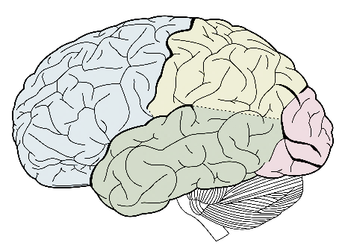
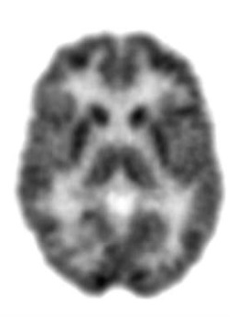
Pre-Processing
Mean gray matter volume (CAT)
MRI
216
2
Standardized uptake value ratio (SPM12)
FDG-PET
216 cortical and subcortical brain regions
2 models (SVR & RVR) with 3 tunable parameters (kernel, degree, C) each

Slide 9
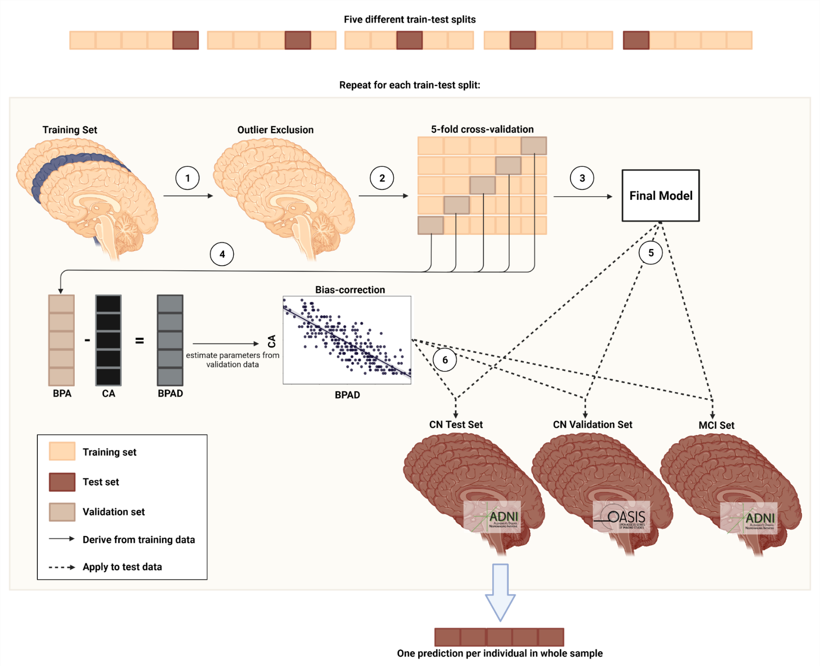
Five predictions per individual in CN_Validation and MCI Set
Figure 1. Pipeline for brain age prediction using nested cross-validation. (1) Outliers are excluded from the training set. (2) Training data is divided into five training/validation folds. (3) Cross-validation yields the final model for brain age prediction. (4) BPAD is used for bias correction. (5) Final model is used to yield predictions for test sets. (6) Bias-correction parameters are applied to test sets. BPA = brain-predicted age; CA = chronological age, BPAD = brain-predicted age difference.
Notes:
How we went about the training process is that we applied what’s called a nested cross-validation procedure. We split the data into four parts training and one part testing. The training data in machine learning approaches is used – as the name suggests – to train the models and obtain a final model with optimal hyperparameters. Thereafter we use the test data to obtain predictions.
In the nested cross-validation approach, we repeated this splitting into training and testing set five times such that each individual in the ADNI cognitively normal sample belonged to a test set once and only once. This allowed us to obtain one independent brain age prediction for all individuals from the ADNI sample. For the OASIS and MCI data on the other hand, because by means of this procedure five different models were trained, we obtained five different but highly correlated brain age predictions per individual in these samples. The results I’m showing to you today are inferred from the first model for simplicity.
After this inner five-fold cross validation, we used the brain age predictions from the validation folds to apply bias correction. In the brain-age prediction literature, we often observe a bias between BPAD and chronological age, wherein younger individuals are predicted to be older and older individuals are predicted to be younger than they actually are. With established bias correction methods, we were able to infer the required parameters to eliminate this bias.

Slide 10
Precision in brain age prediction is comparable across FDG and MRI
Table 2. Precision of predicting chronological age from FDG-PET and MRI scans. For CN_validation and MCI, results of the first model and metrics over all five models are shown.
 | CN |  | CN_validation |  | MCI
 | FDG | MRI | FDG | MRI | FDG | MRI
n total | 345⁺ | 345⁺ | 59⁺ | 59⁺ | 621 | 621
MAE | 1.99 | 1.89 | 1.83 | 2.42 | 1.94 | 2.66
MAE before bias correction | 4.04 | 3.97
Mean (SD) over 5 models | - | - | 2.04 (0.30) | 2.45 (0.19) | 2.17 (0.44) | 2.57 (0.11)
Mean difference | -0.10 | -0.05 | -0.80 | -0.80 | 0.78 | 1.15
Mean (SD) over 5 models | - | - | -0.66 (0.41) | -0.92 (0.16) | 0.77 (0.26) | 1.42 (0.16)
Notes. *After outlier exclusion using CN train set (IQR > 6)
Best model was SVR in 5/5 train-test splits for FDG-PET and MRI.
Notes:
Here I present you results for the comparison between FDG-PET and MRI in brain age prediction.
As we can appreciate from the mean absolute error, or MAE, in the CN sample, the precision of brain age prediction was largely similar between FDG-PET and MRI. The age of cognitively normal individuals was on average underestimated by -0.1 and 0.05 years in the two modalities. This shows that our predictions were very precise.
In the CN_validation sample, FDG-PET did a slightly better job in predicting brain age, as both the mean absolute error and the mean difference were smaller in this modality.
In the MCI group, we found that individuals were estimated older than their actual chronological age by 0.67 and 1.42 years for FDG-PET and MRI, respectively. So we found a bigger difference between chronological and predicted age in the MCI population when using MRI.

Slide 11
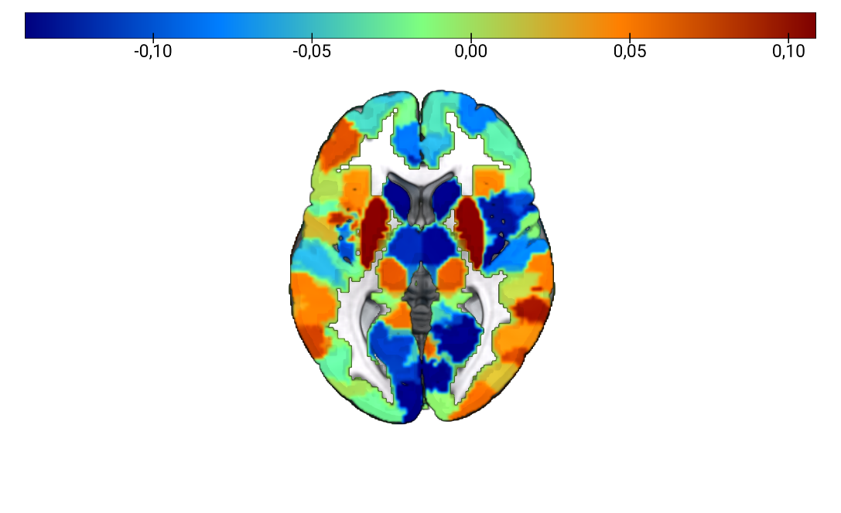
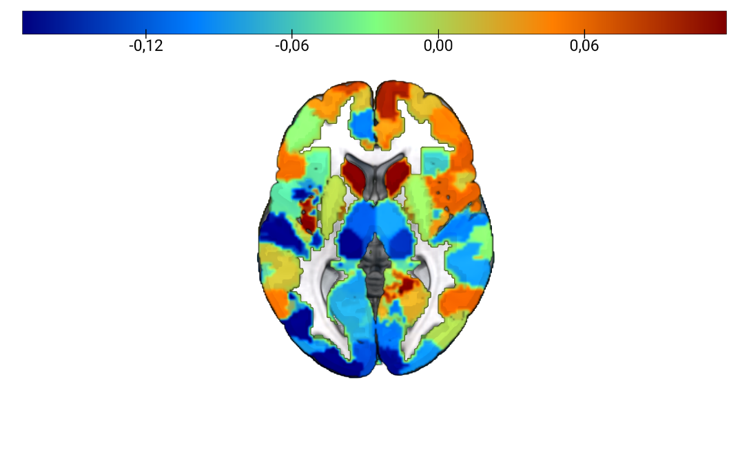
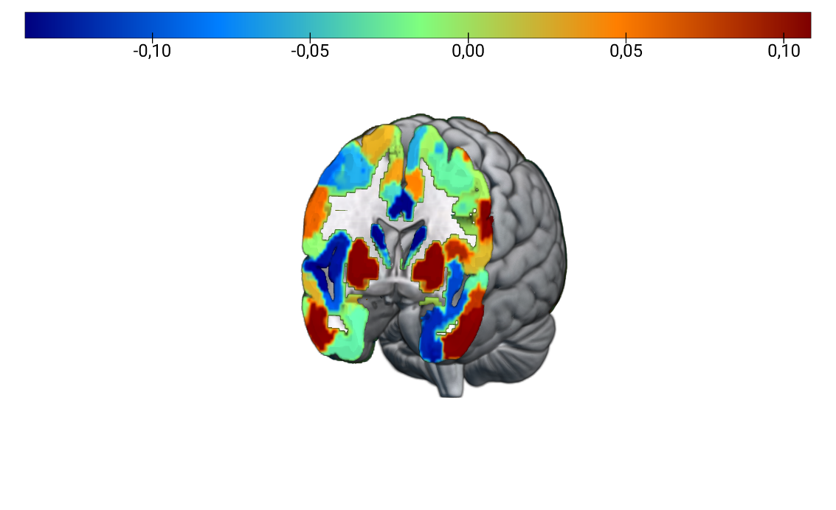
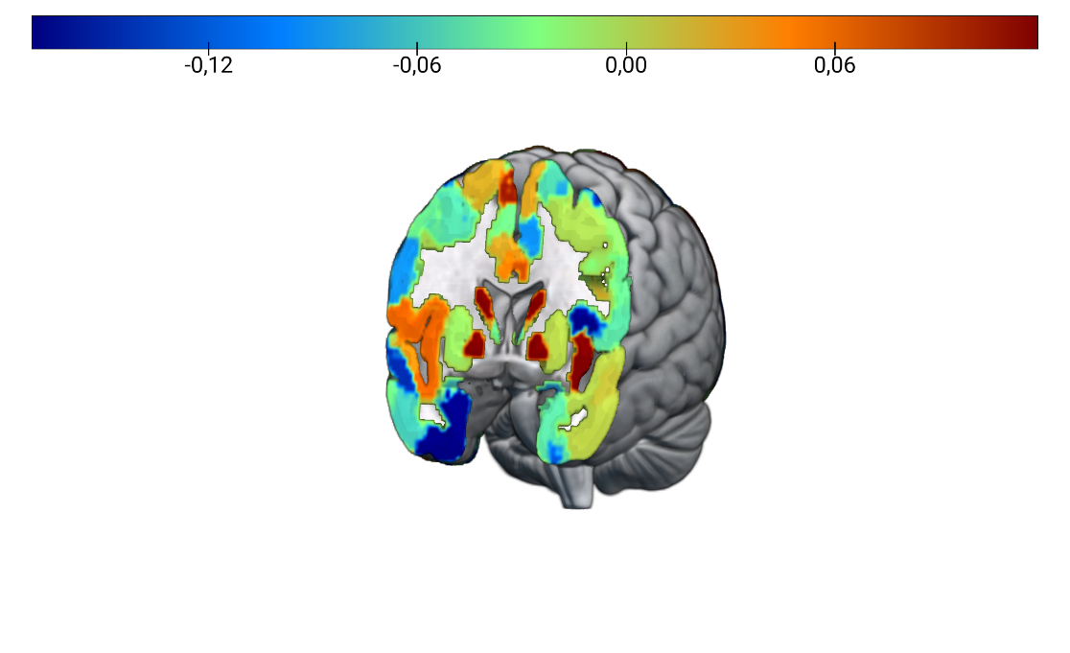
Brain Regions for Prediction of Brain Age are Different between FDG-PET and MRI
FDG-PET
MRI
(A)
(B)
Figure 2. Feature importance for brain age prediction. (A) Average weights of support vector regression across three models for brain age prediction using FDG-PET. Two out of the five train test splits required a non-linear kernel for optimal prediction of brain age. Weights were highly correlated across models (r > 0.8). (B) Average weights of support vector regression across all five models for brain age prediction using MRI. Weights were highly correlated across models (r > 0.8).
Notes:
We see that brain regions important for the prediction of brain age differed between fdg-pet and MRI, but in both FDG-PET and MRI we see that brain regions associated both with aging and disease are relevant for the current task, thereby suggesting that we can define neurodegeneration as a fast progressed form of aging.

Slide 12
Association of BPAD with Cognitive Function, Neuropathology, and Cognitive Decline
Cognitive Function (CF):
Neuropathology (NP):
Cognitive Decline (CD): Diagnosis after 24 months
ADNI-MEM, ADNI-EF
Pearson/Spearman Correlations between BPAD and CF/NP
Partial correlations between BPAD and CF/NP controlling for age and sex
- CSF Aβ, PET amyloid (global AV45), - CSF Tau, CSF Ptau
Logistic Regression to associate BPAD, age and sex with CD

Slide 13

BPAD in CN
Notes:
Now I proceed to showing you results of associations of BPAD with cognitive function, neuropathology and cognitive decline in cognitively normal individuals.

Slide 14
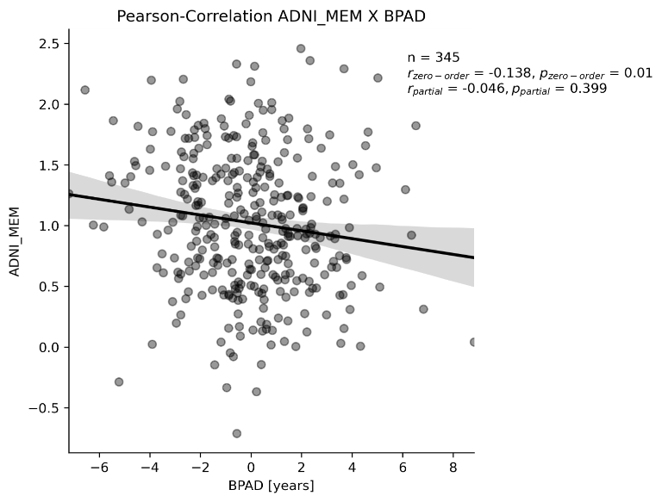
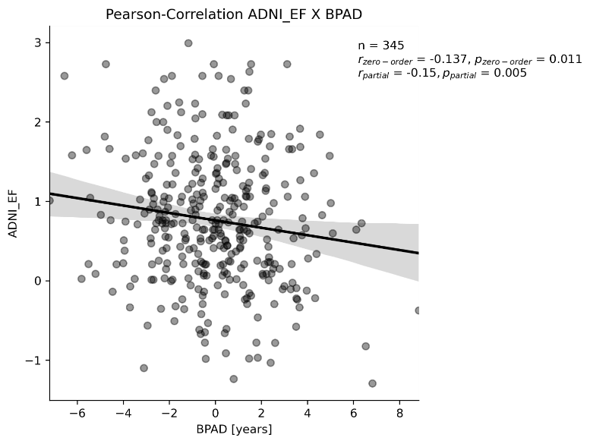
Higher MRI-BPAD is associated with worse cognitive performance in CN
Memory Executive Function
n = 345
r = -0.138**
Not correlated after correction for age and sex
n = 345
r = -0.137**
r_{partial} = -0.150**
* Significant at p < 0.05, ** significant after Bonferroni correction
Notes:
We found that higher MRI- but not FDG-BPAD was associated with worse cognitive performance in cognitively normal individuals. In these graphs here, we can see that both memory and executive function decline as BPAD rises, although only the decline in executive function withstands correction for age and sex in these correlations.

Slide 15
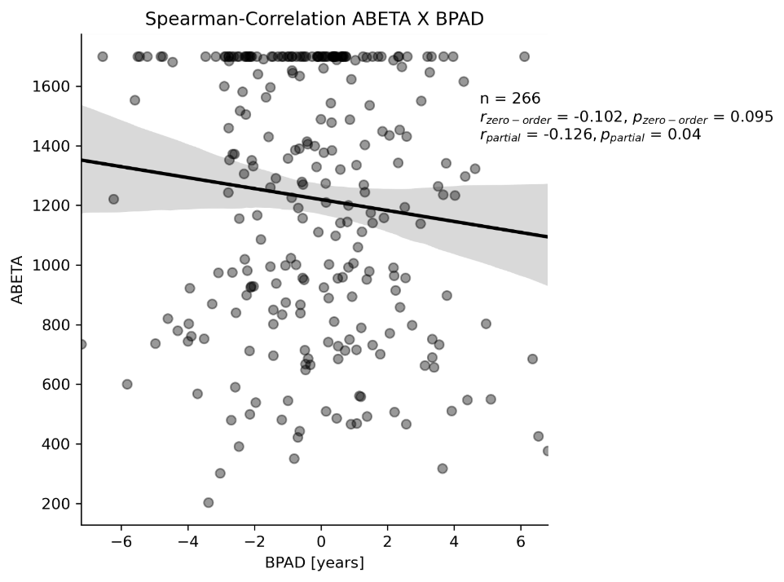
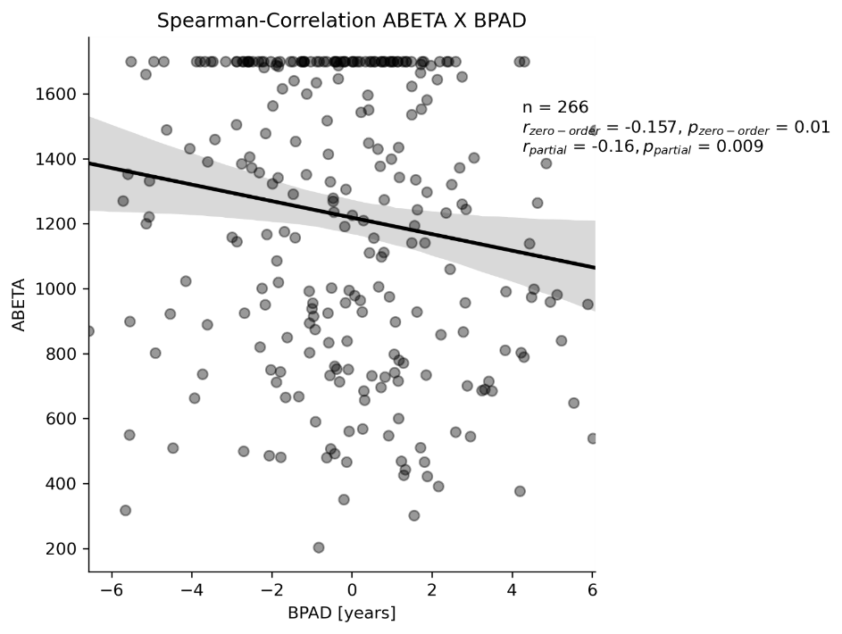
Higher BPAD (esp. FDG) is associated with lower CSF Aβ levels
CSF Aβ
CSF Aβ
n = 266
Not significant without correction for age and sex
ρ_{partial} = -0.126*
n = 266
ρ = -0.157*
ρ_{partial} = -0.160**
* Significant at p < 0.05, ** significant after Bonferroni correction
Notes:
In terms of neuropathology in cognitively normal individuals, however, we found more significant associations between FDG-PET and CSF amyloid beta. MRI BPAD correlations did not survive Bonferroni correction.

Slide 16
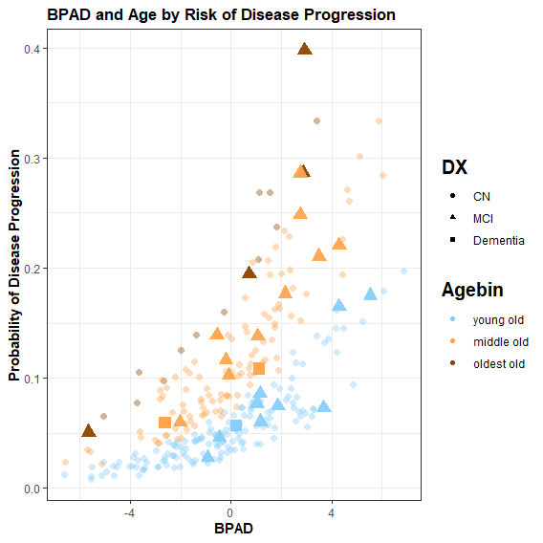
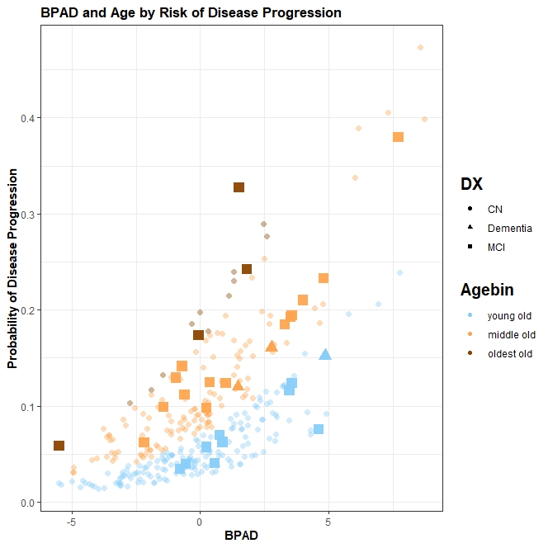
FDG-BPAD predicts conversion to MCI/Alzheimer’s disease in CN
27% increased odds to develop (mild) cognitive impairment within two years per one year BPAD (95%CI [7%, 51%])
age: OR = 10% (95%CI [3%, 19%])**, sex not significant in logistic regression
negative BPAD
Total: 153
Converters: 8 (5%)
positive BPAD
Total: 142
Converters: 18 (13%)
27%
**
.
Diagnosis after 24 months
CN (n=305)
MCI (n=23)
AD (n=3)
Age Category
Young old (<75 y.)
Middle old (75 – 84 y.)
Oldest old (> 85 y.)
* Significant at p < 0.05, ** p < 0.01, *** p < 0.001
0
Notes:
Finally, a diagnosis of MCI or Alzheimers disease two years after the scans were taken was significantly predicted from FDG BPAD. We found that the odds of someone converting to an MCI/AD diagnosis within two years are increased by 27% for every additional year in BPAD. The graph on the right shows individuals’ BPAD plotted against der predicted probability of disease progression. We see that both increasing BPAD, the position on the x-axis, and increasing age, the colors, contribute to a higher probability of conversion.
MRI BPAD did not significantly predict a person’s diagnosis in two years.

Slide 17
BPAD in MCI
Notes:
Now I proceed to showing you results of associations of BPAD with cognitive function, neuropathology and cognitive decline in patients diagnosed with mild cognitive impairment.

Slide 18
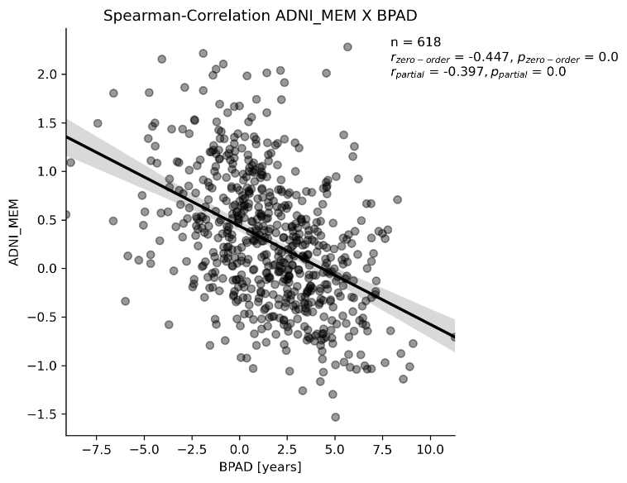
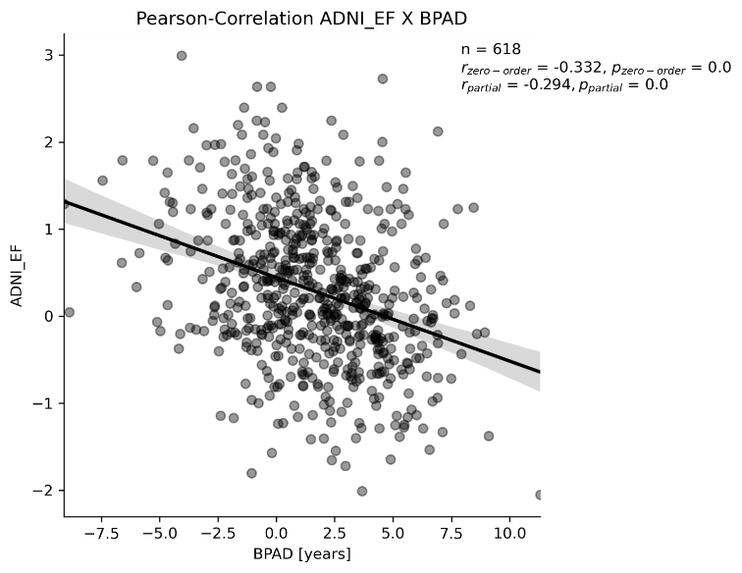
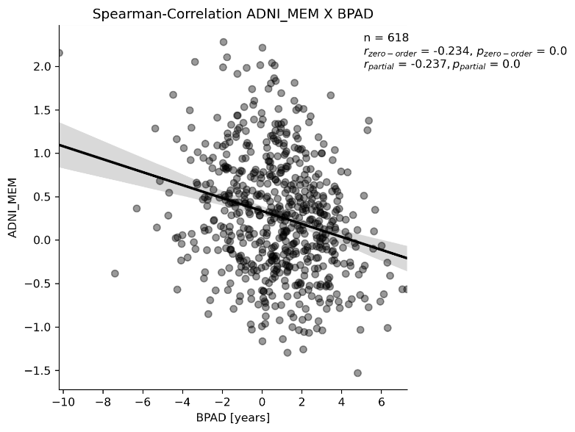
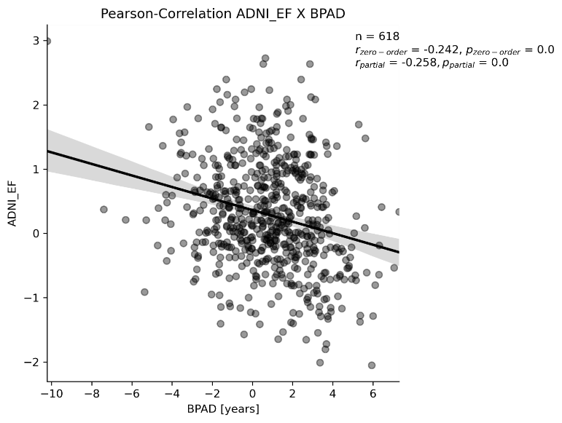
Higher BPAD (esp. MRI) is associated with worse cognitive performance in MCI
Memory Executive Function
Memory Executive Function
n = 618
r = -0.332**
r_{partial} = -0.294**
n = 618
ρ = -0.447**
ρ_{partial} = -0.397**
n = 618
r = -0.332**
r_{partial} = -0.294**
n = 618
ρ = -0.234**
ρ_{partial} = -0.237**
n = 618
r = -0.242**
r_{partial} = -0.258**
* Significant at p < 0.05, ** significant after Bonferroni correction
Notes:
Higher BPAD in both modalities is associated with worse memory and executive function scores. All correlations were significant with and without correction for age and sex and withstood Bonferroni correction. A Fisher transformation of the correlation coefficients revealed that memory decline was associated more strongly with MRI-BPAD as compred to FDG-BPAD, while no significant difference was found for the decline in executive function.

Slide 19
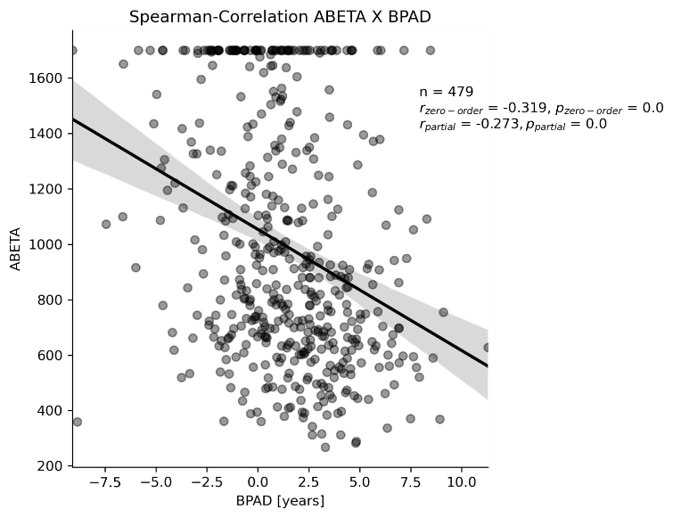
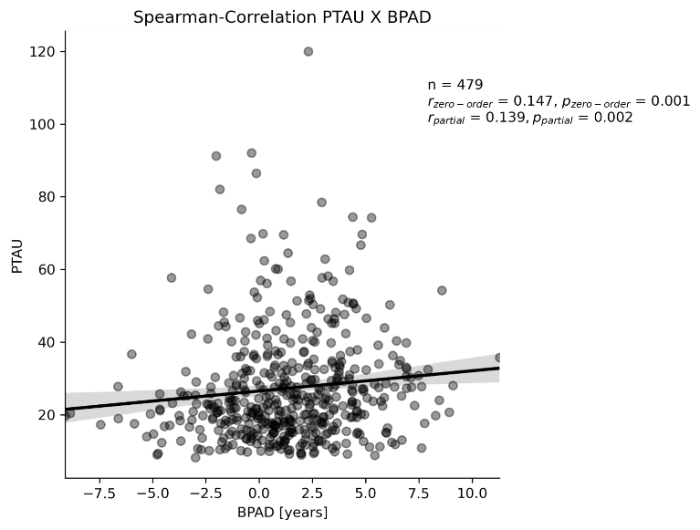
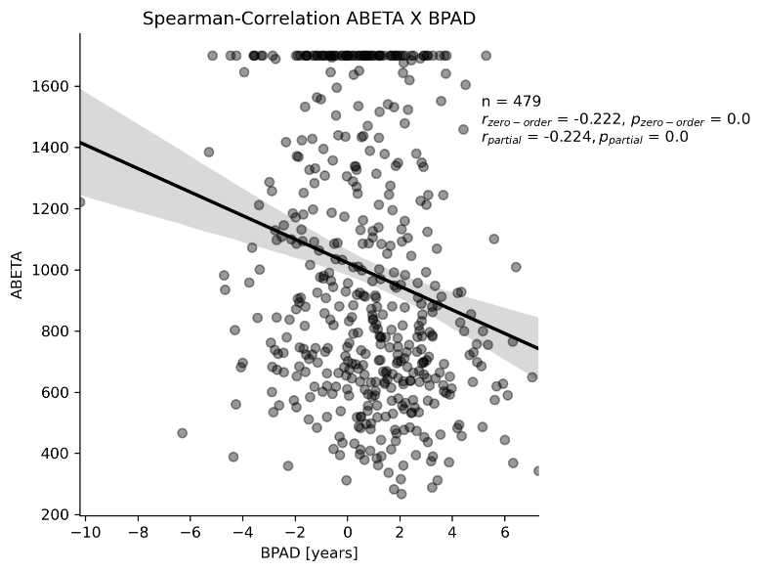
Higher BPAD (esp. MRI) is associated with more neuropathology in MCI
Amyloid PTau
Amyloid Tau/PTau
n = 479
ρ = -0.319**
ρ_{partial} = -0.273**
n = 479
ρ = 0.147**
ρ_{partial} = 0.139**
n = 479
ρ = -0.222**
ρ_{partial} = -0.224**
* Significant at p < 0.05, ** significant after Bonferroni correction
Notes:
Especially MRI-BPAD was also associated with enhanced neuropathology in terms of CSF and PET amyloid, as well as CSF tau and phosphorylated tau. FDG-PET was associated comparably strong with amyloid, however there were no correlations with measures of tau in patients with mild cognitive impairment.

Slide 20
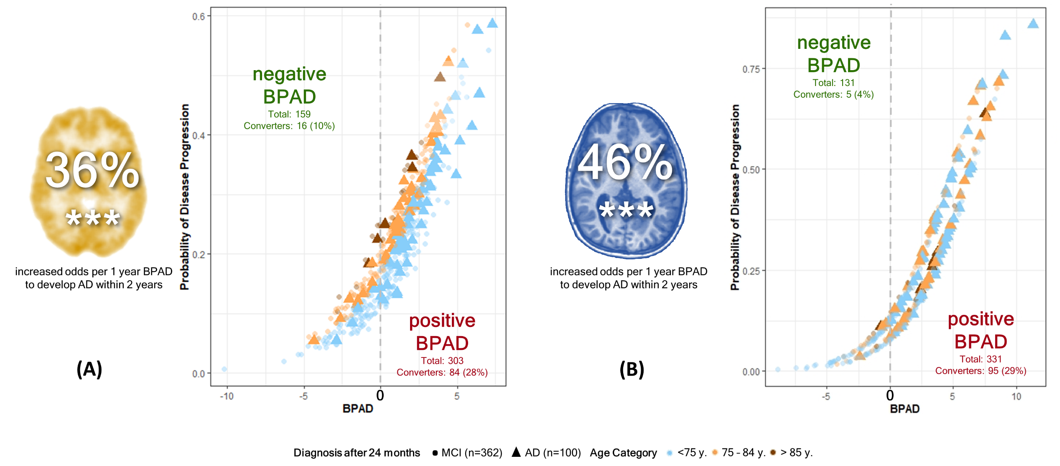
Higher BPAD predicts conversion to Alzheimer’s disease in MCI
Figure 3. BPAD and Age by Risk of Disease Progression in MCI. Results from logistic regression to predict an AD diagnosis after 24 months: (A) Odds to develop AD within 24 months increase by 36% per one year FDG-PET-derived BPAD. Age also significantly predicts disease progression. (B) Odds to develop AD within 24 months increase by 46% per one year MRI-derived BPAD.
Notes:
Finally, a diagnosis of Alzheimers disease two years after the scans were taken was significantly predicted from BPAD in both modalities. From these two graphs showing the probability of progression to Alzheimer’s disease by BPAD and age, we can appreciate that especially in MRI, the fitted logistic regression makes use of BPAD to predict the development of Alzheimer’s disease. If we compare the numbers of individuals converting to Alzheimer’s disease in negative and positive BPAD, we find that only a minority of individuals with a negative MRI-BPAD convert to AD, while a considerable 29% with a positive BPAD will convert to AD. This distinction appears less clear on the right-hand side, where results for FDG-PET are portrayed. For both modalities, the odds of developing Alzheimer’s disease within the next two years increase by a considerable percentage per one year BPAD, almost 50% for MRI-BPAD!

Slide 21
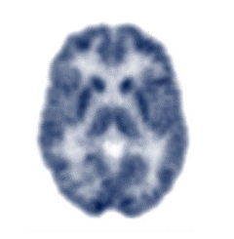
And the winner is…
Brain age can be predicted comparably well from FDG-PET or MRI, but…
Cognitive Performance
AD Neuropathology
Disease Progression
CN
FDG-PET-predicted age better captures early disease-related neuropathology and risk.
Onset of tau-related neurodegeneration and of objective cognitive decline is more strongly associated with signals of increasing brain age on MRI.
MCI
First study to compare FDG-PET- and MRI-predicted brain age
First study to acknowledge the benefit of making the decision on modality based on disease stage
Notes:
So now let’s wrap it up.
We found that brain age can be predicted comparably well from FDG-PET or MRI, however
READ

Slide 22

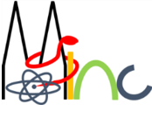


















Thank you for your attention!
Dr. Gérard Bischof
(PostDoc)
Dr. Kathrin Giehl
(Study coordinator)
Dr. Merle Hönig
(PostDoc)
MultiModal
Prof. Dr. Thilo van Eimeren
Head of MMNI Group,
Dpt. of Neurology & Nuclear Medicine
Dr. Hendrik Theis
(MD)
NeuroImaging
Elena Doering
(PhD student)
Prof. Dr. Simon Eickhoff
Director of the Institute Brain and Behaviour (INM-7)
Dr. Kaustubh Patil
Leader of the research group “Applied Machine Learning”
Group.de
Verena Dzialas
(PhD student)
Julia Pfeil
(PhD student)
Prof. Dr. Alexander Drzezga
Head of Dpt. Nuclear Medicine
& INM-II, Research Center Jülich
Magdalena Banwinkler
(PhD student)
Dr. Georgios Antonopoulos
(PostDoc)
Adrian Asendorf
(PhD student)
Contact info: elena.doering@uk-koeln.de

Slide 23
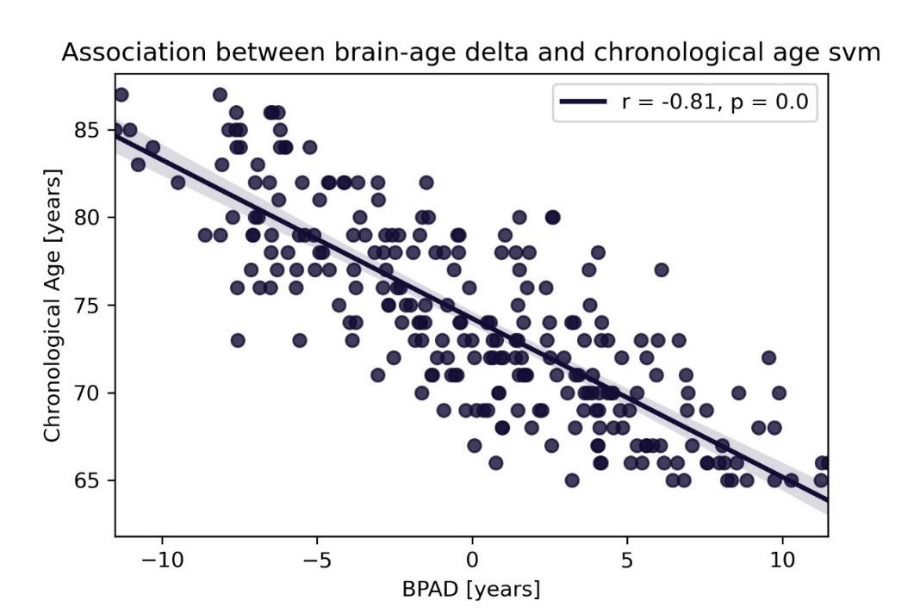
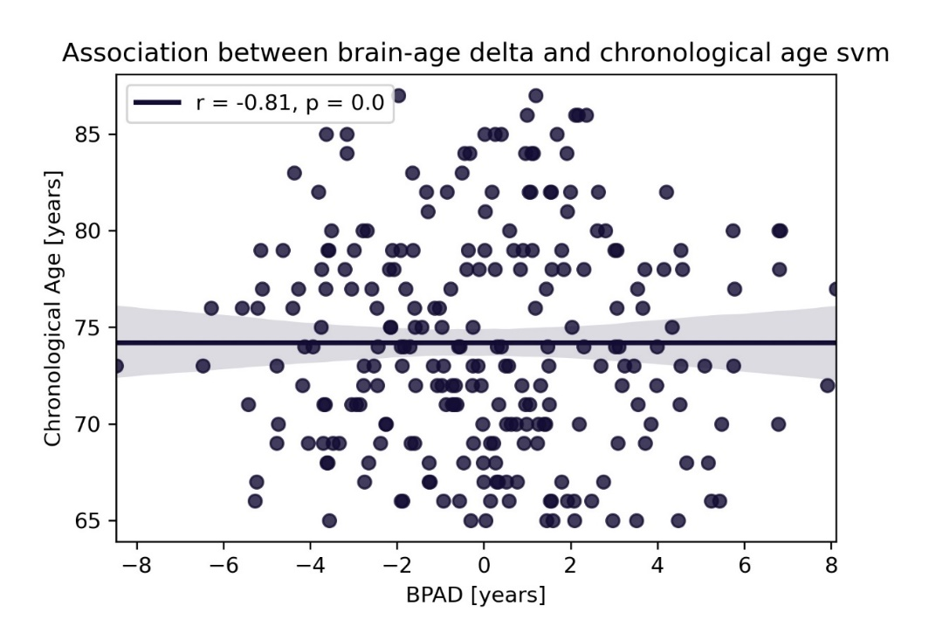
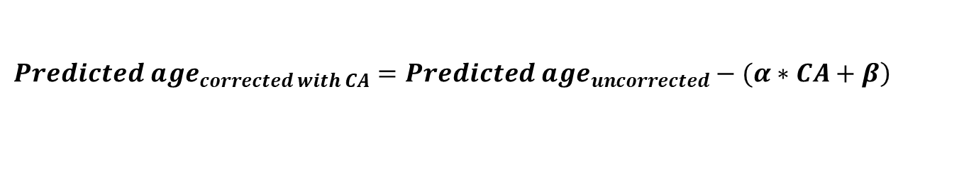
Bias Correction
$$\left.{Predicted age}_{corrected with CA}={Predicted age}_{uncorrected}−(α∗CA+β\right)$$
α = slope; β = intercept from linear model of CA X BPAD
PET
0, p = 1.0
Notes:
It is a very commonly observed phenomenon in brain age prediction that younger individuals are predicted to be older, while older individuals are predicted to be younger, as you can see in the left graph on this slide. This bias was corrected for by creating a linear model of chronological age and BPAD, and subsequently subtracting the inferred parameters from the predicted age.

Slide 24
Across Models…
Stronger and more significant correlations with neuropathology/cognitive function using MRI-BPAD.
Table 3. Correlation strength (rho or r) between BPAD and neuropathology/cognitive function across five different models
 | FDG-PET |  | MRI
 | Zero-order | Partial | Zero-order | Partial
CSF ABETA | -0.222 [-0.237; -0.172] | -0.186 [-0.224; -0.135] | -0.316 [-0.319; 0.305] | -0.269 [-0.279; -0.266]
AV45 (global SUVR) | 0.137 [0.113; 0.154] | -- | 0.197 [0.176; 0.217] | 0.173 [0.163; 0.202]
CSF Tau | -- | -- | 0.127 [0.121; 0.138] | 0.124 [0.114; 0.138]
CSF PTau | -- | -- | 0.146 [0.141; 0.157] | 0.139 [0.131; 0.153]
ADNI-MEM | -0.279 [-0.321; -0.234] | -0.250 [-0.257; -0.234] | -0.455 [-0.459; -0.443] | -0.409 [-0.420; -0.397]
ADNI-EF | -0.272 [-0.323; -0.241]* | -0.255 [-0.258; -0.219]* | -0.325 [-0.339; -0.307]* | -0.290 [-0.301; -0.286]*
Notes. Median [range] of correlation coefficients are displayed when significant (p<0.05) correlation existed in brain-predicted age according to all five models. Coefficients are Spearman Rho unless marked by an asterisk (*: Pearson’s r coefficient).
A table of all correlation coefficients and their p values will go into the supplementary materials.

Slide 25
Across Models…
Stronger and more significant increase of odds of conversion using MRI-BPAD.
Table 4. Odds ratio to develop Alzheimer’s disease within two years with a baseline diagnosis of MCI across five models.
 | FDG-PET | MRI
BPAD | 32% [16%; 36%] | 46% [44%; 53%]
Sex | -- | -41 [-40%; -42%]
Age | -- | --
Notes. Median [Range] percentage increase is displayed per one year increase in BPAD or if sex = Male. Sex was a significant predictor in 0/5 models in FDG-PET and 3/5 models in MRI. Age was a significant predictor in 1/5 models in FDG-PET and 0/5 models in MRI.
A table of all p-values of the logistic regression, ORs and their 95% CI will go into the supplementary materials.
Notes:
XX what are 95% CI, how do you calculate it

